Slide 1
Comp3000 Project: Netmanager – NCM Application
James White

Slide 2
Project Idea
Network Configuration & Management Application for automated configuration, management and monitoring of a network
Includes additional security automation for implementing network security features (e.g. access lists, port security etc.) based on set security polices
User will be able to log in to view and manage the network through the GUI avoiding direct access to network devices

Slide 3

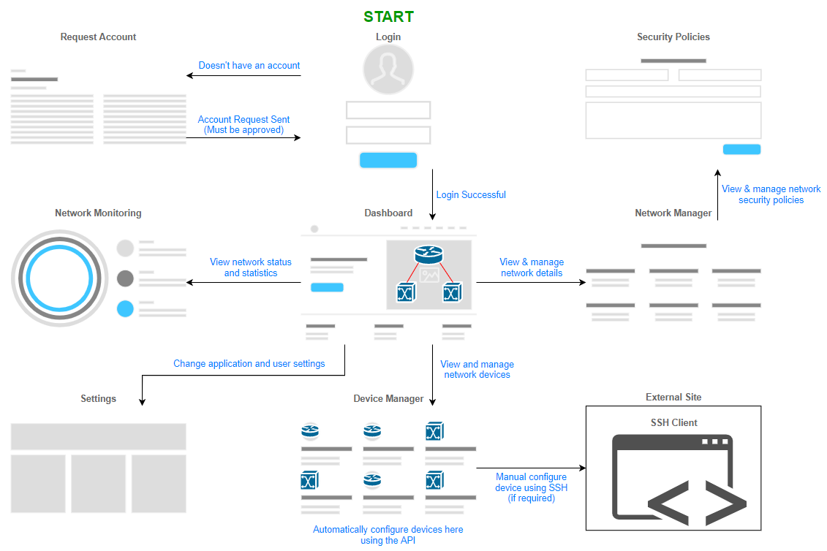
Current Progress
Pre-development testing
Netmiko SSH scripts
NAPALM – Python automation package
User Functionality
Backend development
Ubuntu server with:
GNS3 Remote Server Django/Gunicorn Web Server

Slide 4
Next Sprint
Finish developing the backend
GUI Design
Design & build webpages
Python network scripts

